Slide 1
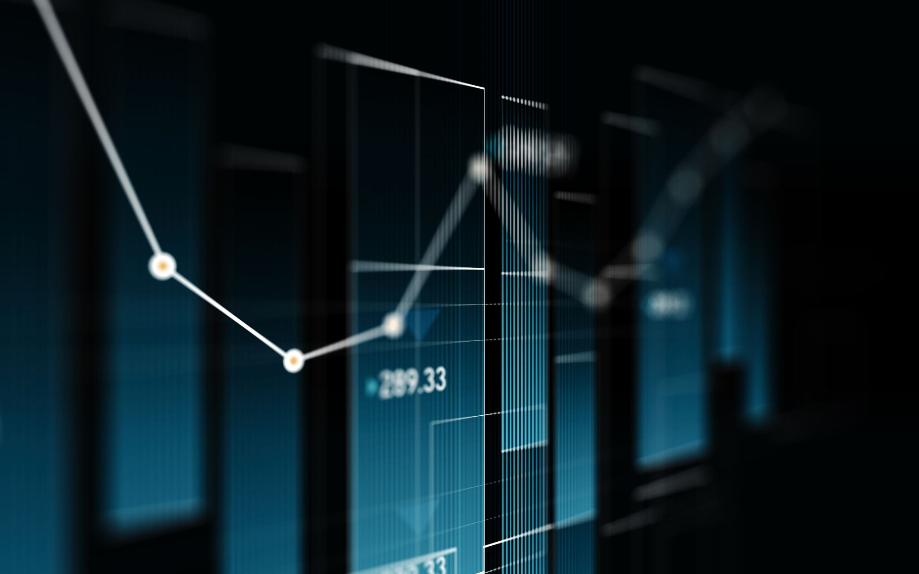
Stock Market Prediction with Machine Learning and Deep Learning Models
Project Team: Yashashvini Rachamallu, Deeksha Mohanty, Uta Nishii
Notes:
Hello everyone, our project is "Stock Market Prediction with Machine Learning and Deep Learning Models". My team includes Deeksha, Uta, and myself Yashashvini.
Today, we will delve into the crucial realm of stock market prediction, a field that holds immense significance in financial decision-making.

Slide 2

Motivation
Importance of society interests in the company (tweet) for the decision-making
Challenges in integration of historic data and the raw data as such as tweets.
Need a good predictor, helps in reliable forecasting of stocks data
Notes:
In the world of finance, the accuracy of stock market predictions is not just a matter of profit and loss; it's about understanding and navigating the complexities of the global economy. This is where our project steps in, utilizing the power of machine learning and deep learning. These technologies aren't just tools; they represent a paradigm shift in how we approach financial forecasting. Our goal is ambitious yet grounded: to create a sophisticated system that does more than just predict stock prices. We're aiming to redefine accuracy in market forecasts, bringing a level of precision that can transform the way investors and traders make decisions. With each advancement in technology, we're not just chasing numbers; we're seeking to unlock deeper insights into the financial markets, aiding in more informed, strategic decision-making processes.

Slide 3

Objective
Choosing a set of companies for analysis.
Web scraping the tweets i.e, talk of the society on the stocks.
Visualizing the stocks data.
Building the model to predict the next 7 days stock prices.
Combining historical stock data with current sentiment analysis for robust classification.
Notes:
In our pursuit of achieving this goal, we've chosen a diverse set of companies for our analysis, including big companies like Amazon and emerging players like Hertz. Why these companies? Because they offer a broad spectrum of data, reflecting various market dynamics. But we didn't stop at just historical data. We integrated this with sentiment analysis, capturing the pulse of the market as reflected in news and media. This combination allows us to not only see what happened in the past but also understand the current market sentiment. Such a comprehensive approach is key to developing a predictive model that is robust, accurate, and reflective of real-world complexities.

Slide 4
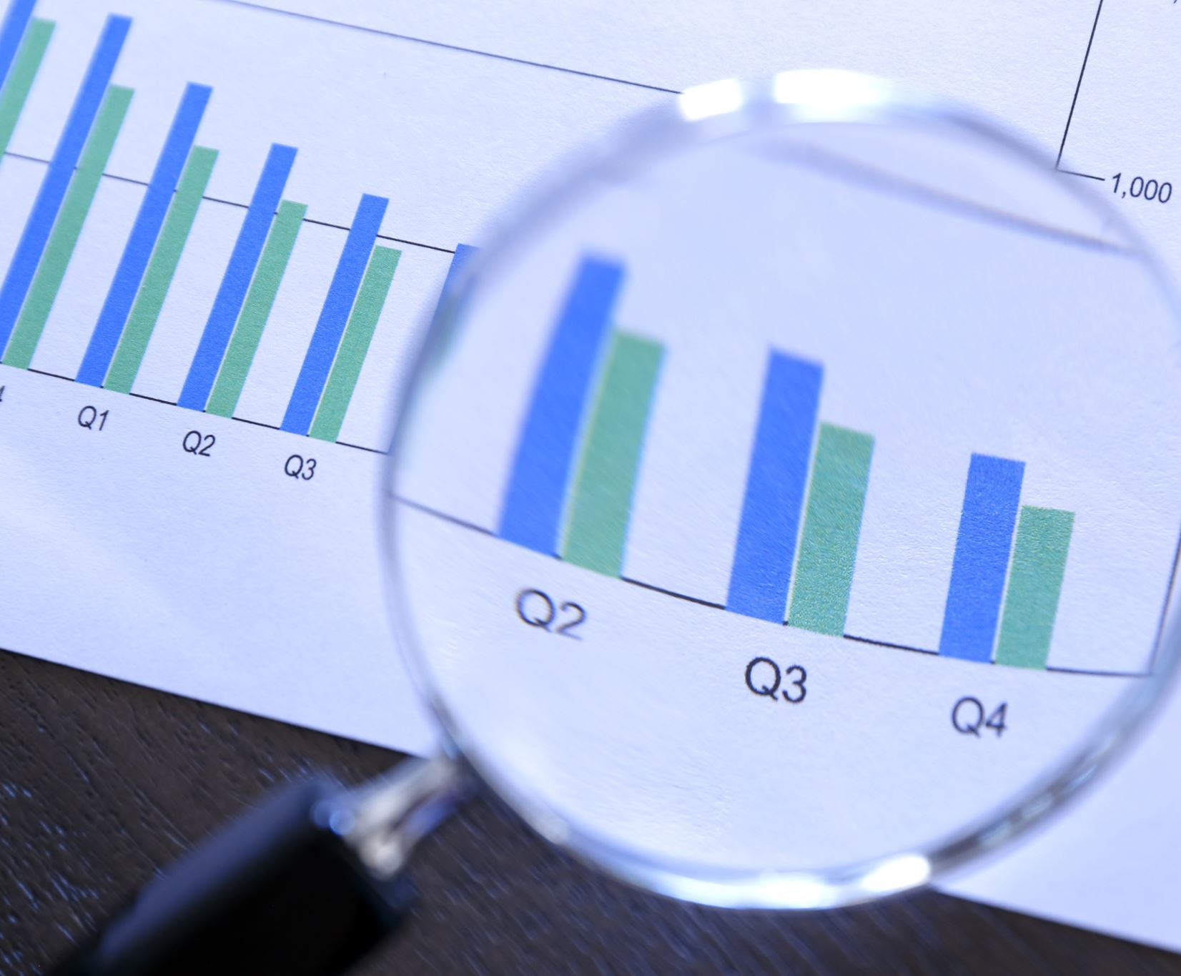

Data Collection
Primary Data Sources: Yahoo Finance and finviz.com
Historical Financial Data and Real-time News Data
Companies Analyzed: Hertz Global Holdings, Chevron Corporation, Barclays PLC, Toyota, Amazon, Walmart, Google
Notes:
Let's begin with our data collection process. Our primary sources were Yahoo Finance for historical financial data and Finviz for real-time news data. We targeted a diverse range of companies, including Hertz, Chevron, Barclays, Toyota, Amazon, Walmart, and Google, to ensure a comprehensive analysis. The historical data provided us insights into stock performance trends, while real-time news data from Finviz helped us understand market sentiments. This dual approach allowed us to create a robust dataset that not only reflects past performance but also captures current market dynamics, crucial for accurate forecasting.

Slide 5
Data Preprocessing
Text Preprocessing and Sentiment Analysis
Handling Missing Values and Data Cleaning
Tools Used: Vader Sentiment Analyzer, Custom Scripts for Data Cleaning
Notes:
Moving on to data preprocessing, which was vital to ensure the quality and accuracy of our analysis. We employed text preprocessing techniques to clean news data, removing unnecessary characters and stop words. This was followed by sentiment analysis using the Vader Sentiment Analyzer, which helped us quantify market sentiments as positive, negative, or neutral. For the historical financial data, we addressed the challenges of missing values due to factors like national holidays. We used custom scripts to clean and format the data, ensuring that our datasets were not only comprehensive but also tailored for our specific analytical needs. This meticulous preprocessing was essential to provide a solid foundation for our predictive models.

Slide 6

Visualizations

Slide 7
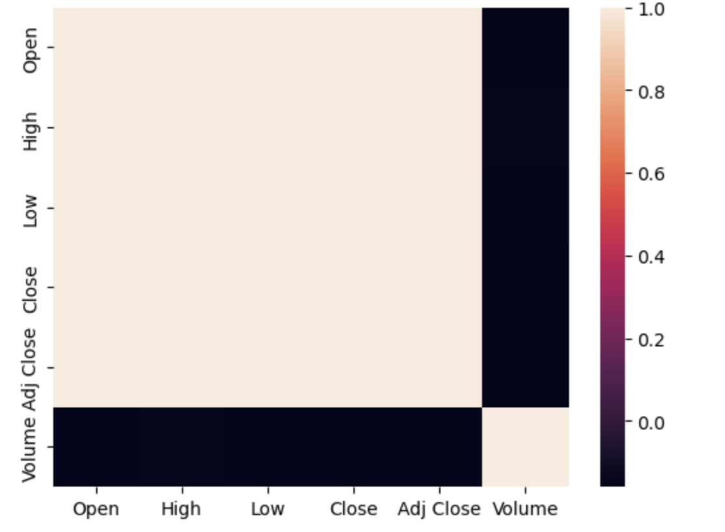
Heat Map
The heat map shows a high correlation among all attributes, indicated by the consistent shade, with values close to 0.99.

Slide 8
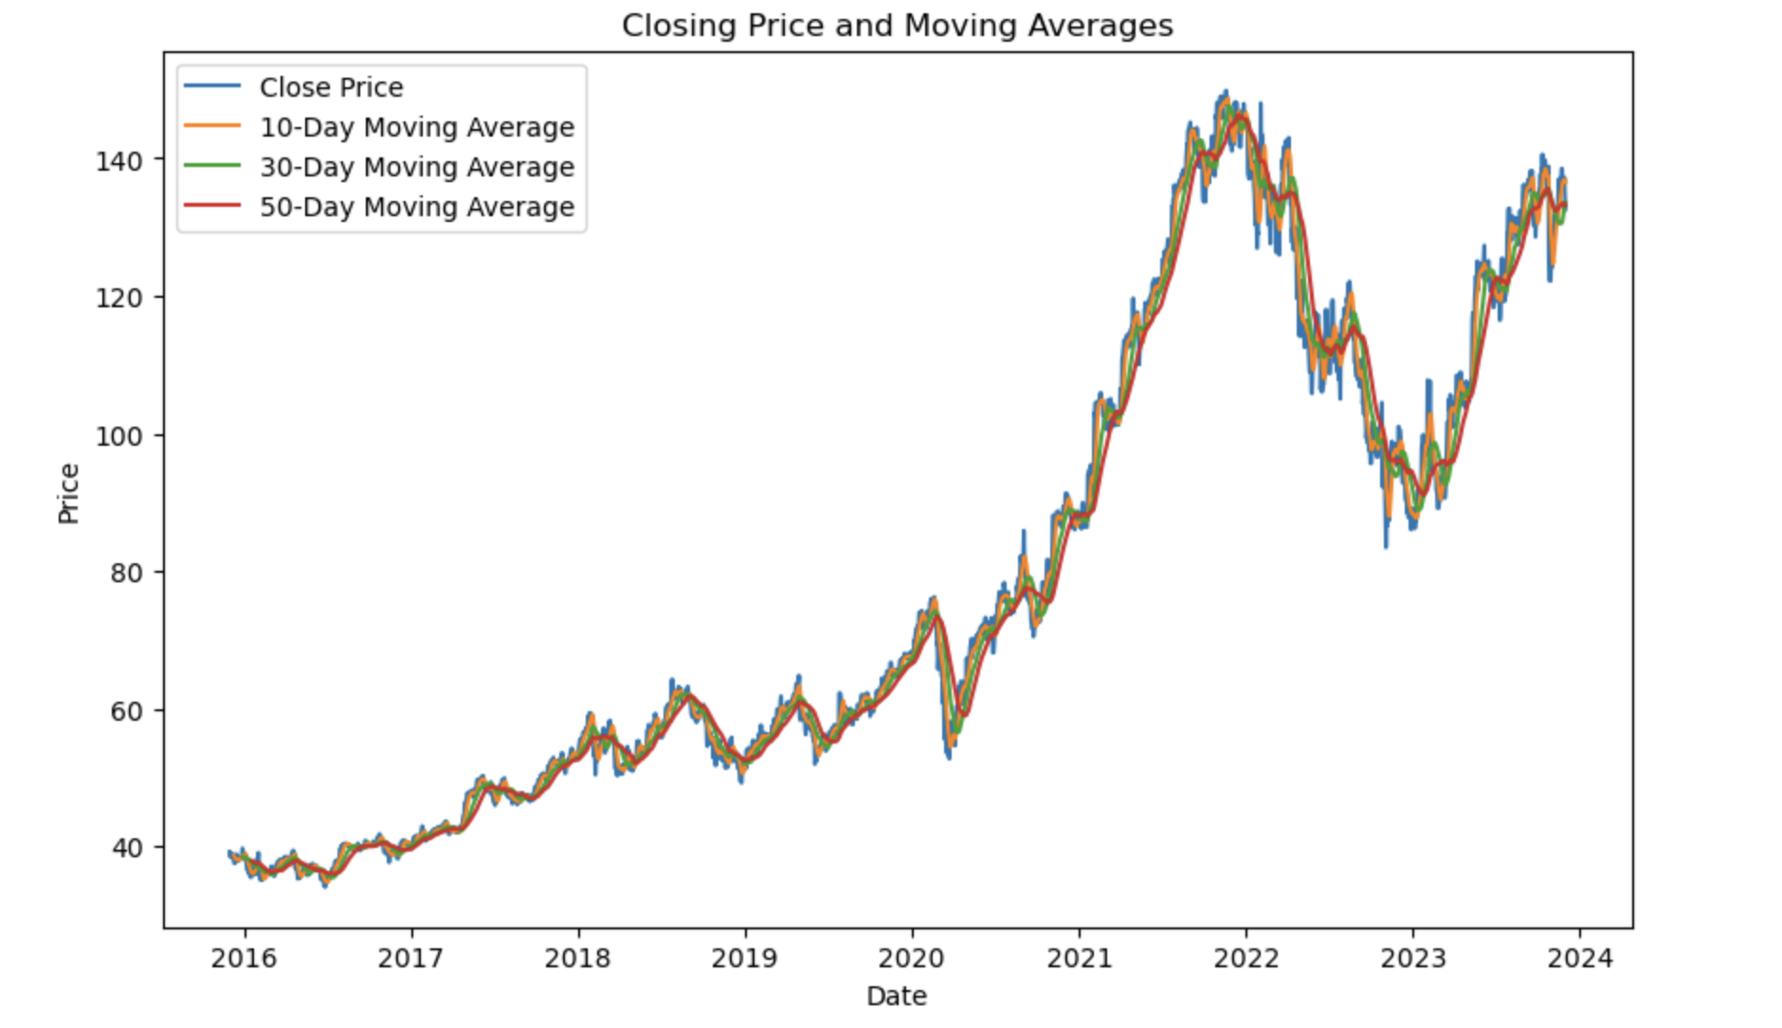
Moving Averages Chart
By using moving averages of different lengths (e.g., 50-day, 100-day, 200-day), we compare short-term trends against long-term trends.
Convergence or divergence of these averages can indicate potential market changes.

Slide 9
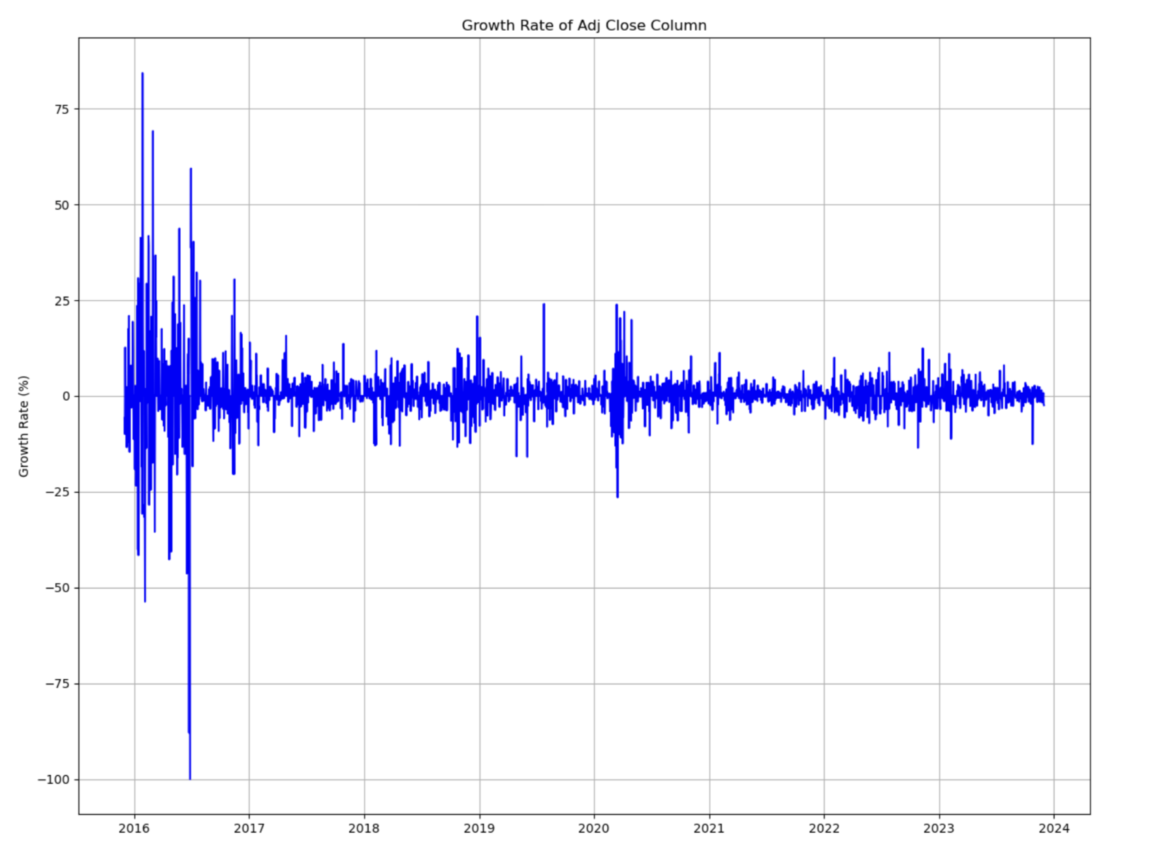
Growth Rate Chart
In Growth Rate charts, a consistently positive growth rate indicates an uptrend, whereas a consistently negative growth rate suggests a downtrend.

Slide 10
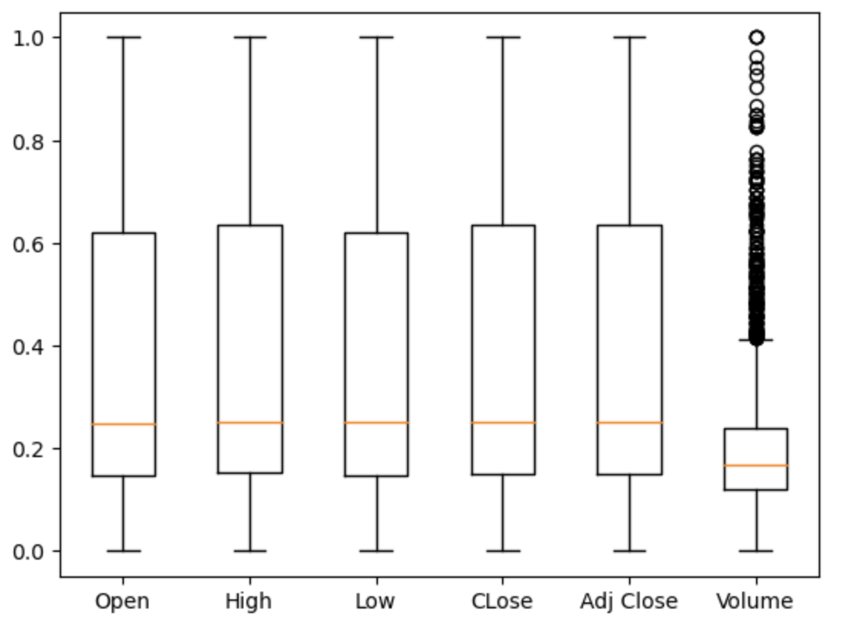
Box Plot analysis In the box plot, it is noticeable that there are no outliers in any of the data attributes except for Volume.

Slide 11
Methodology

Slide 12
Goal: Invest / Not Invest
Best Model Analysis
Retrain Model to forecast next seven days
Invest/Not Invest

Slide 13
Custom Script Development for Data Integration
Overcoming Data Inconsistencies and Anomalies
Addressing Missing Values and Data Quality Issues
DATA COLLECTION &
DATA PROCESSING

Slide 14
PREDICTIVE MODELING
ML Models
Neural Network
ARIMA

Slide 15
CLASSIFICATION MODELING
Training best model on 7 Datasets
Predict the next 7 days adj close values [Normal Data], append sentiment scores if available [Hybrid Data]
Perform Logistic Regression on Normal Data and Hybrid Data.
Invest Recommendation [Input - Stock Name, Date]

Slide 16

Challenges
Lack of tweets data for all stock tickers
Lack of continuous financial data for all stock tickers
The volatility of the stock market makes accurate prediction challenging
Problems in prediction for long-term investment using algorithms
Notes:
Let's begin with our data collection process. Our primary sources were Yahoo Finance for historical financial data and Finviz for real-time news data. We targeted a diverse range of companies, including Hertz, Chevron, Barclays, Toyota, Amazon, Walmart, and Google, to ensure a comprehensive analysis. The historical data provided us insights into stock performance trends, while real-time news data from Finviz helped us understand market sentiments. This dual approach allowed us to create a robust dataset that not only reflects past performance but also captures current market dynamics, crucial for accurate forecasting.

Slide 17

RESULTS

Slide 18
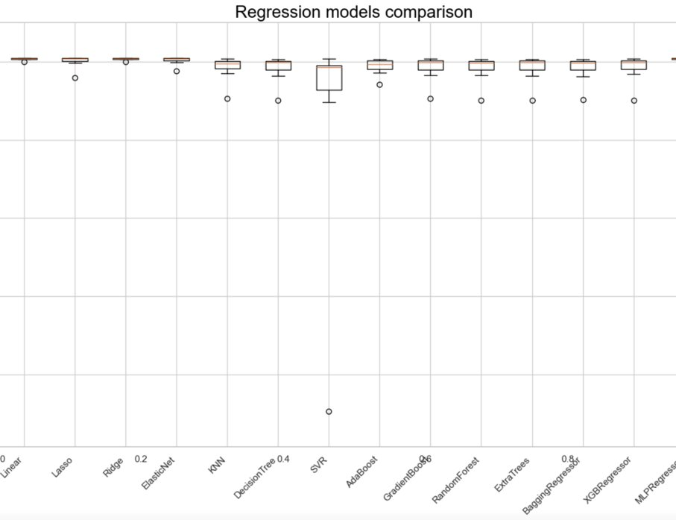
From this boxplot, we are able to see that Linear Regression and MLPRegressor models perform particularly well.

Slide 19
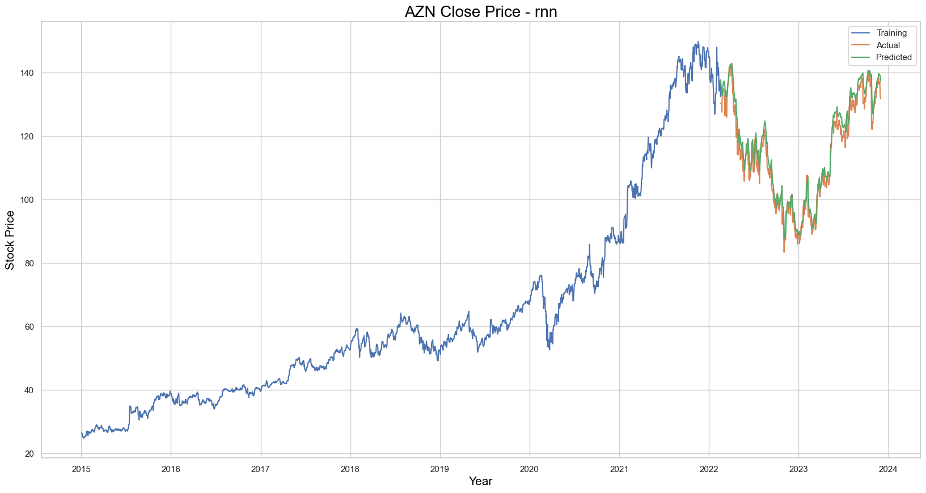
BEST MODEL PLOT

Slide 20

Without including sentiment scores, if the user inputs a particular stock ticker and the current date, then they get the prediction of whether they should invest or not the next seven days with about 63% accuracy.
While including sentiment scores, if the user inputs a particular stock ticker and the current date, then they get the prediction of whether they should invest or not the next seven days with about 47% accuracy.

Slide 21

Conclusion
Successful in predicting the next 7 days adj close value for the particular date.
Unsuccessful, when the sentiment score, comes to picture due to lack of data.
Notes:
- Summarize the project's success, key learnings, and any limitations encountered.
- Outline future steps or potential improvements.

